Slide 1
IMS Project
Ali Khattab – 21SepSoftware

Slide 2
Introduction
Who am I?
Brief: Design and build an Inventory Management System (IMS) for a store
How did I approach the specification?

Slide 3








Consultant Journey
Technologies learned for this project:

Slide 4
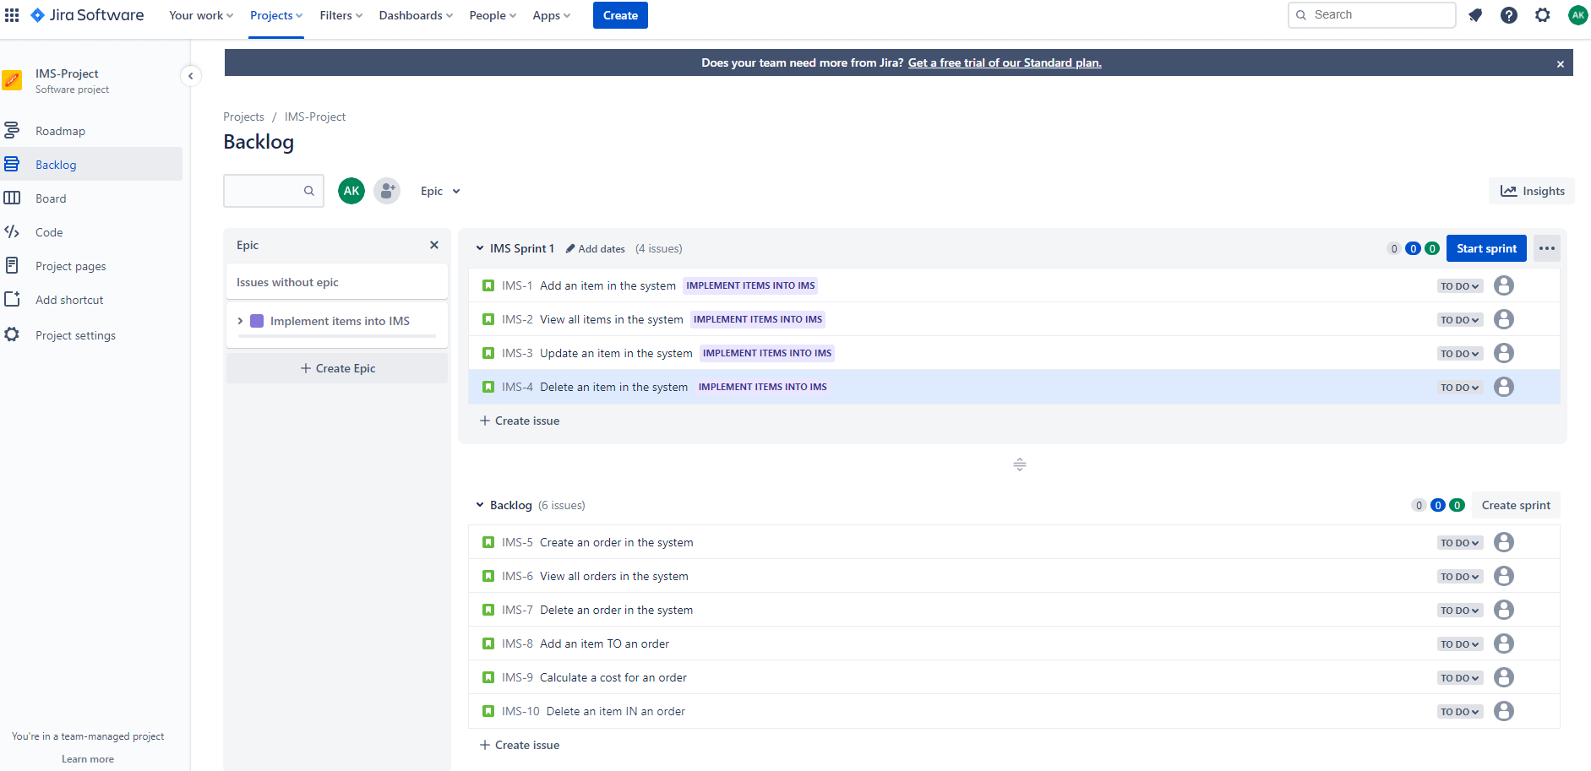
Jira

Slide 5
Continuous Integration
Version Control System – Git
Cloud-based hosting service – GitHub
Smart commits from GitHub linking to Jira

Slide 6
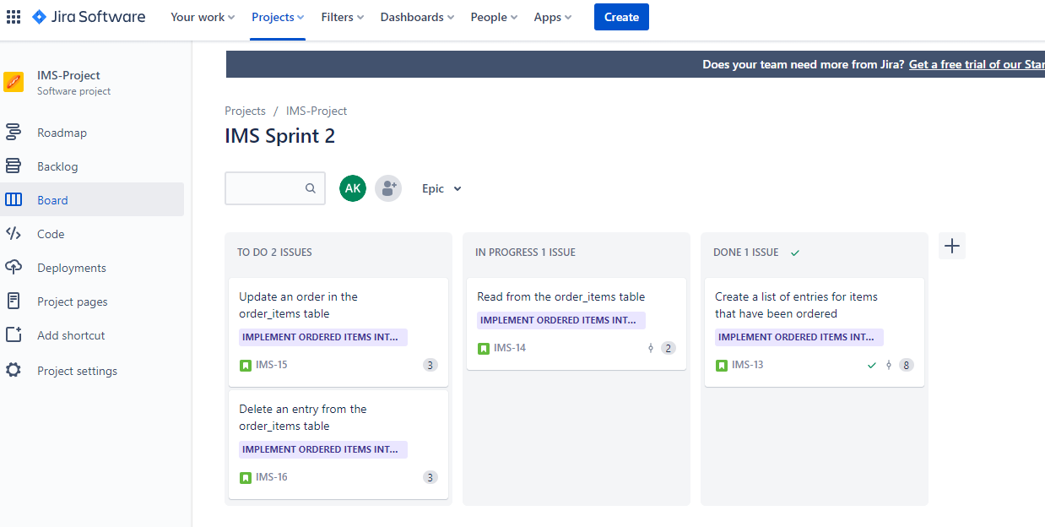
Jira Sprint

Slide 7
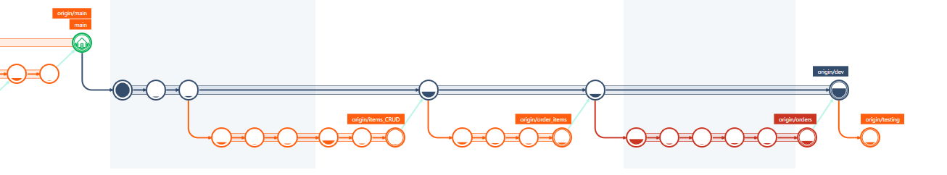
GMaster
Feature Branch Model

Slide 8
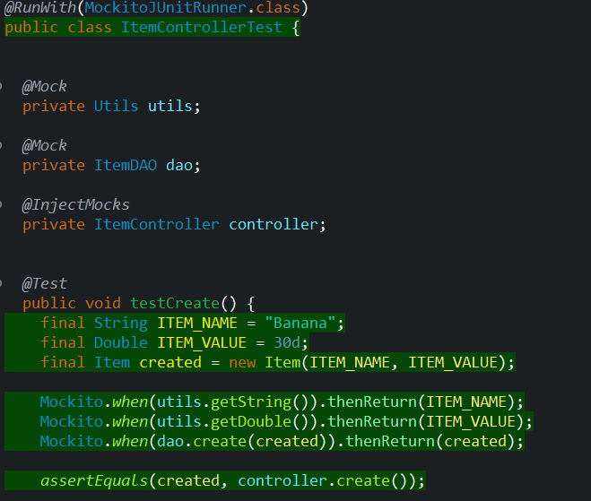
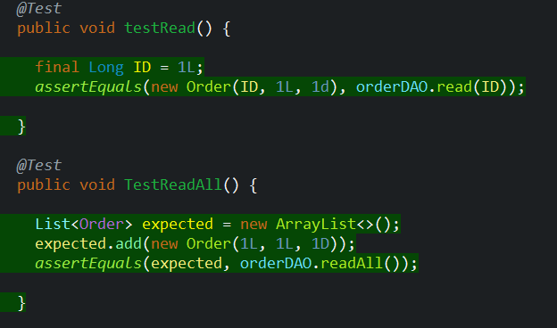
Testing

Slide 9
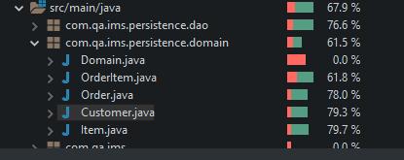
Testing Coverage

Slide 10
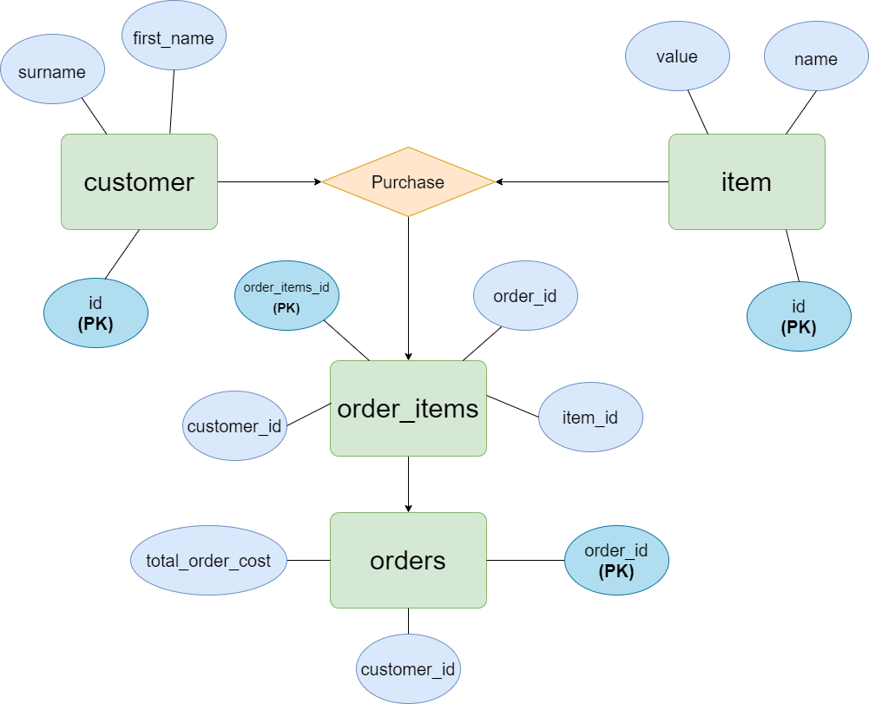
Entity Relationship Diagram

Slide 11
Entity Relationship diagram
order_item_id | order_id | customer_id | item_id
1 | 1 | 9 | 3
2 | 1 | 9 | 4
3 | 1 | 9 | 4
4 | 1 | 9 | 6
5 | 2 | 4 | 8
6 | 2 | 4 | 4
order_id | customer_id | total_cost
1 | 9 | 17.0
2 | 4 | 12.0

Slide 12
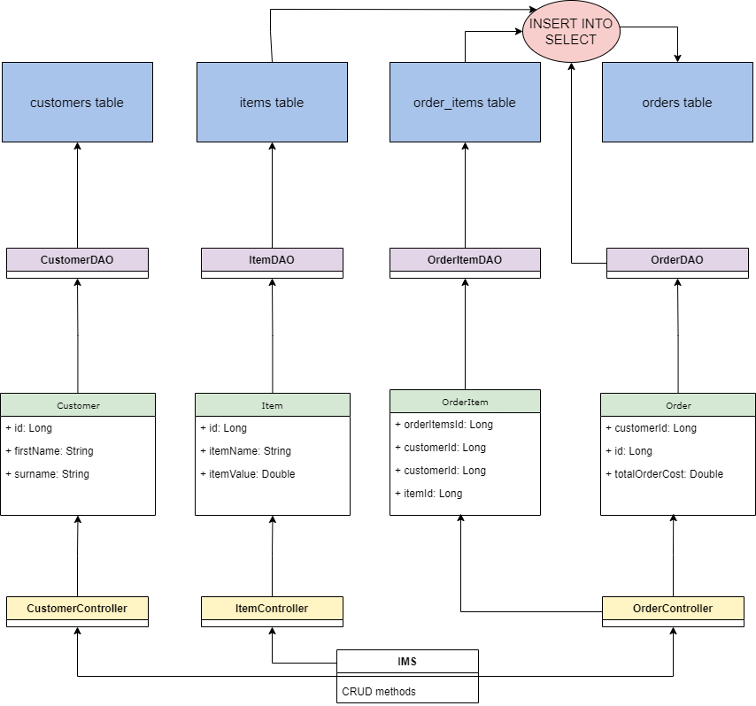
UML Diagram

Slide 13
Demonstrations

Slide 14
Sprint Review
What did I complete
MVP of IMS including:
MySQL database
Full Java Backend application with CRUD functionality
What got left behind
Testing above 80%

Slide 15
Sprint retrospective
What went well?
Managed to get a working solution
Planned my project around diagrams ti help simplify the development
Using feature branch models within GitHub
What could be improved?
Write tests as past of the feature branch as development goes along
More functionality in the console
More comments in source code to make things clearer

Slide 16
Conclusion
Questions?
GitHub: https://github.com/aliktb/IMS-Starter
Jira: https://emaplejiralxc1.atlassian.net/jira/software/projects/IMS/code

